Slide 1

Chapter 5
The Global Context of Business
Copyright © 2014 Pearson Canada Inc.
5-<number>

Slide 2
Learning Objectives
Describe the rise of international business and identify the major world marketplaces
Describe the evolving role of emerging markets and highlight the important role of the BRICS nations.
Explain how different forms of competitive advantage, import–export balances, exchange rates, and foreign competition determine the ways in which countries and businesses respond to the international environment
Copyright © 2014 Pearson Canada Inc.
5-<number>
Notes:
These learning objectives are based upon those at the beginning of the chapter. For a review of learning objectives, see the summary at the end of the chapter, as well as the list of key terms.

Slide 3
Learning Objectives
Discuss the factors involved in deciding to do business internationally and in selecting the appropriate levels of international involvement and international organizational structure
Describe some of the ways in which social, cultural, economic, legal, and political differences act as barriers to international trade
Explain how free trade agreements assist world trade
Copyright © 2014 Pearson Canada Inc.
5-<number>
Notes:
These learning objectives are based upon those at the beginning of the chapter. For a review of learning objectives, see the summary at the end of the chapter, as well as the list of key terms.

Slide 4
The Contemporary Global Economy
(LO 5-1)
Total volume of world trade ≈ $15 trillion/yr
Globalization
  the integration of markets globally
  the world is becoming a single interdependent system
  International trade stats
Copyright © 2014 Pearson Canada Inc.
5-<number>
Notes:
4
4
4
Learning Objective: 5-1
Notes
The world volume is large and growing. It is important for students to understand the potential of the global economy and its effects on Canada’s growth. The economy is becoming less fragmented and more of a single market network. This means that it is important for firms to have a presence beyond Canadian borders. Canada, itself, is a small and limiting market. The real rewards for Canadian business lie outside the nation.
Activities
1) Have students research the sales of a global marketing firm located in Canada (eg: Procter & Gamble). Have students discuss:
What percentage of their revenues come from Canadian markets? From global markets? Where does their greatest potential for growth lie?

Slide 5
The Contemporary Global Economy
(LO 5-1)
Imports
  products purchased in Canada that are manufactured and shipped in from other countries
Exports
  products made in Canada that are purchased by consumers in other countries
  http://www.intracen.org/itc/market-info-tools/trade-statistics/ WHAT DOES CANADA IMPORT/EXPORT AND WHAT ARE THE TOP 5 COUNTRIES?
Copyright © 2014 Pearson Canada Inc.
5-<number>
Notes:
5
5
5
Learning Objective: 5-1
Activities
Have students make a list of items in their homes which come from other nations. Are they aware of Canadian-made substitutes? Would they be willing to switch? Why or why not?
Have students research the top 10 countries that Canada exports to. If the US accounts for the lion’s share of our exports, how many countries are needed to make up the remaining 20%? How does this affect our economic stability? Growth? What does Canada have to do in the future?

Slide 6
The Contemporary Global Economy
(LO 5-1)
Major World Marketplaces
North America
  our largest trading partner is the United States
  Mexico exports increasing
Europe
  Western and Eastern
Pacific/Asia
  Japan, China, and India
Copyright © 2014 Pearson Canada Inc.
5-<number>
Notes:
6
6
6
Learning Objective: 5-1
Activities
Have students look up the most recent statistics on trade with various countries.

Slide 7
Emerging Markets
https://www.economist.com/special-report/2017/10/07/defining-emerging-markets?zid=295&ah=0bca374e65f2354d553956ea65f756e0
BRICS – special category (Brazil, Russia, India, China, South Africa) https://www.weforum.org/agenda/2016/04/what-is-the-state-of-the-brics-economies/
Copyright © 2014 Pearson Canada Inc.
5-<number>
Notes:
6
6
6
Learning Objective: 5-1
Activities
Have students look up the most recent statistics on trade with various countries.

Slide 8
Forms of Competitive Advantage
(LO 5-3)
Absolute advantage
  a country can produce something more cheaply or better than any other country
  Canada’s absolute advantage is in agricultural production because of its vast areas of low-cost, undeveloped land. https://www.investopedia.com/terms/a/absoluteadvantage.asp
Comparative advantage
  a country can produce certain items more cheaply than it can other items (farming in Canada)
Copyright © 2014 Pearson Canada Inc.
5-<number>
Notes:
9
9
9
Learning Objective: 5-3
Notes
Countries seldom produce everything needed or wanted by their people. Therefore, some foreign trade is required. Nations tend to trade those things that they can produce most easily, or more cheaply.

Slide 9
Canada’s National Competitive Advantage
(LO 5-3)
  Canada’s trade strengths are concentrated in industries that extract natural resources and process raw materials. These areas of strength – in which Canada has an outsized share of global trade – include agricultural and food products like wheat, meat, and oilseeds; mineral products like natural gas and metals; and forest products like wood and paper. As well, our strength in the utilities sector comes entirely from electricity exports.”
  https://www.conferenceboard.ca/press/newsrelease/12-06-19/Canada_s_Trade_Strengths_Come_From_Natural_Resources_and_Related_Industries.aspx?AspxAutoDetectCookieSupport=1 “
Copyright © 2014 Pearson Canada Inc.
5-<number>
Notes:
9
9
9
Learning Objective: 5-3
Notes
Countries seldom produce everything needed or wanted by their people. Therefore, some foreign trade is required. Nations tend to trade those things that they can produce most easily, or more cheaply.

Slide 10
Forms of Competitive Advantage
(LO 5-3)
Theory of National Competitive Advantage – Porter’s Diamond
  Focus on four key conditions
Factor Conditions
Demand Conditions
Related and Supporting Industries
Strategies, Structure, and Rivalries
Copyright © 2014 Pearson Canada Inc.
5-<number>
Notes:
9
9
9
Learning Objective: 5-3
Figure 5.1
Notes
Countries seldom produce everything needed or wanted by their people. Therefore, some foreign trade is required. Nations tend to trade those things that they can produce most easily, or more cheaply.

Slide 11
Forms of Competitive Advantage
(LO 5-3)
Balance of Trade
  the difference in value between total exports and total imports
Trade Surplus
  A nation that exports more than it imports has an favourable balance of trade
Trade Deficit
  A nation that imports more than it exports has an unfavourable balance of trade
Copyright © 2014 Pearson Canada Inc.
5-<number>
Notes:
10
10
10
Learning Objective: 5-3
Figure 5.2
Table 5.1
Notes
Balance of Trade is the difference between the total value of exports, and the total value of imports. If exports exceed imports the nation has a trade surplus which is a positive thing. This way, trade brings additional revenues (net) into the nation. If imports exceed exports the nation has a trade deficit. This means that more revenues are leaving the nation than are coming in via trade. This is a negative thing.
Activities
Discuss the downside of a reliance on trade with the US. What can be done about it? How has the recession of 2008 impacted on our trade worldwide?
Have students map the exports and imports for Canada for the last 35 years. Then, have them calculate the trade surplus (or deficit) for each year. Is Canada better off, or worse off, than it was 25 years ago?

Slide 12
Forms of Competitive Advantage
(LO 5-3)
Balance of Payments
  Refers to the flow of money into or out of a country
cash flow in
  exports
  foreign tourist spending in Canada
  foreign investments in Canada
  earnings from Canadian investments outside of Canada
cash flow out
  imports
  Canadian tourist spending overseas
  foreign aid grants
  military spending abroad
  Canadian investment abroad
  earnings from foreign investment in Canada
Copyright © 2014 Pearson Canada Inc.
5-<number>
Notes:
Learning Objective 5-3
Figure 5.3

Slide 13
Foreign Exchange Rate
(LO 5-3)
Ratio of one currency to another
  “strong” Cdn $ when high demand for Canadian $$ and products
  when the value of the Cdn $ depreciates
    exports increase and imports cost more
  when the value of the Cdn $ appreciates
    exports decrease and imports cost less
Copyright © 2014 Pearson Canada Inc.
5-<number>
Notes:
12
12
12
Learning Objective: 5-3
Case 5-2
Notes
The rate of exchange has seen the value of the Canadian dollar fall for over 20 years. This stimulates the sale of exports to Canada’s main trading partner, the US. It does little, however, to enable Canadian consumers to afford foreign imports. Since 2004, the value of the dollar has been increasing against the US dollar.
Activities
Have students obtain prices (in Canadian dollars) for five hard consumer durables (such as home furnishings, appliances, automobiles, etc.) being marketed by Canadian firms. To gain an understanding of the impact of exchange rates, have students go to www.oanda.com and use the online currency converter to express these prices in foreign currencies. Suggested foreign currencies are: United States dollars, British Sterling, Euros, Japanese Yen, Mexican Pesos and Australian Dollars. Also, students may be given a chance to choose a few currencies on their own. To finish the exercise, as them how the exchange rate on the Canadian dollar would impact the Canadian firm’s export opportunities.

Slide 14
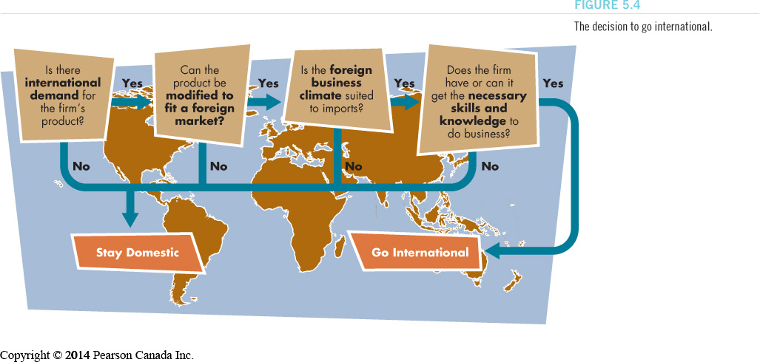
International Business Management
(LO 5-4)
Going International
Copyright © 2014 Pearson Canada Inc.
5-<number>
Notes:
Learning Objective: 5-4
Figure 5.4
Activities
Questions for Analysis #2

Slide 15
International Business Management
(LO 5-4)
Exporter
  (makes in one country and sells to others)
Importer
  (buys products in foreign markets for resale at home)
International Firm
  conducts much of its business abroad
  basically, a domestic firm with international operations
Multinational Firm
  controls assets, factories, mines, sales offices, and affiliates in two or more foreign countries
  basically, planning and decision making are geared to international markets
Copyright © 2014 Pearson Canada Inc.
5-<number>
Notes:
18
18
18
Learning Objective: 5-4
Notes
There is debate about multinationals. Some claim that they create wealth by providing jobs and technology. Others argue that multinationals take profits out of the country and do nothing to promote the jobs of local employees.
Activities
Have students debate the multinationals’ influence on foreign nations: are they pro or con?

Slide 16
International Business Management
(LO 5-4)
International Organizational Structures
Importing or Exporting via Independent Agent
Licensing Arrangement
Establishing a Branch Office
Choosing a Strategic Alliance
Foreign Direct Investment
Copyright © 2014 Pearson Canada Inc.
5-<number>
Notes:
14
14
14
Learning Objective: 5-4
Notes
There are several ways of entering markets. Exporting and importing may simply involve the use of intermediaries, independent agents which are based in the host country to work in concert with the Canadian exporting firm.
- A licensing agreement allows the exporter to let foreign-based firms produce, sell or distribute the product. In return, the exporting firm receives a royalty fee based on sales volume. This saves the exporter the time and money of having to establish a manufacturing/marketing firm in the foreign nation.
- A subsidiary is a firm which is based in the foreign country, but wholly owned by the domestic firm which is exporting to that country. World product mandating occurs when the foreign subsidiary is given responsibility for research, development and/or manufacturing a product line.
- Strategic alliances (joint ventures) involve partnerships between domestic exporters and foreign-based firms. They work together to design, produce, distribute and/or market a product in the foreign nation.
- Foreign Direct Investment is buying or establishing tangible assets in another country
Activities
Application Exercises #1

Slide 17
International Business Management
(LO 5-4)
Why Have an Independent Agent?
Local individual or organization who represents exporter’s interests
Often sells products, collects payments, and ensures customer satisfaction
Understands the language, culture, and market
Copyright © 2014 Pearson Canada Inc.
5-<number>
Notes:
Learning Objective: 5-4

Slide 18
International Business Management
(LO 5-4)
Why Have Licensing Arrangements?
Exporter gives a foreign company the exclusive right to manufacture or sell its product for a royalty or fee
Franchising is a special form of a licensing arrangement
Copyright © 2014 Pearson Canada Inc.
5-<number>
Notes:
Learning Objective: 5-4

Slide 19
International Business Management
(LO 5-4)
Why Have a Branch Office?
Established in foreign country
Increased sales due to local presence
More direct control
May be a foreign legal requirement
Copyright © 2014 Pearson Canada Inc.
5-<number>
Notes:
16
16
16
Learning Objective: 5-4
Notes
Some nations require that manufacturing occur on their own soil for products marketed in their country. This helps to create jobs and keep some wealth in their own nation.
Activities
Have students research the type of involvement required to do business in different nations. Let each student present their findings to the class for discussion.

Slide 20
International Business Management
(LO 5-4)
Why Form a Strategic Alliance?
“Joint venture” or “partnership” between two independently owned firms
May be mandated in some nations
Get knowledge and expertise of the foreign partner
Greater control
Copyright © 2014 Pearson Canada Inc.
5-<number>
Notes:
17
17
17
Learning Objective: 5-4
Notes
In some cases foreign nations do not allow foreigners to own property. This requires that firms who desire a higher level of involvement than using independent agents or licensing to enter into a partnership with a locally based firm.
Advantages of the joint venture include: access to markets, products or technology, cost and risk-sharing, sharing manufacturing facilities, and financing.
Activities
Have the students research various firms which are involved in such strategic alliances. Students may present the information to the class including: firms involved in joint ventures, the nations involved, and the nature of the joint venture. If the firms are public companies they may also research the financial and shareholder information to demonstrate success of the joint venture.

Slide 21
International Business Management
(LO 5-4)
Why Foreign Direct Investment?
Companies buy or establish tangible assets in a foreign country (location benefits)
Brings foreign investment to local economy
Provides local employment
Copyright © 2014 Pearson Canada Inc.
5-<number>
Notes:
Learning Objective: 5-4
Table 5-2
Notes
Recently there has been controversy about foreign nationals buying Canadian companies. The major concern is this may damage the Canadian economy as head offices may be moved out of Canada and therefore the decision-making will move as well. This may lead to unfavourable decisions for Canadian companies and therefore its workers.

Slide 22
Barriers to International Trade
(LO 5-5)
Social and cultural differences
Economic differences
Legal and political differences
  quotas/tariffs/subsidies
  protectionism
  local-content laws
  business-practice laws
Copyright © 2014 Pearson Canada Inc.
5-<number>
Notes:
Learning Objective: 5-5
Case 5-1
Notes
Social differences address the differences in habits, lifestyle and demographics across nations. Cultural differences embrace variations in the values that people hold that shape their lives. Such values can be embraced in different religious and/or ethnic groups. Social and cultural differences affect the way consumers shop and the products/services they purchase.
Economic differences occur when government is involved to a different extent in the commercial dealings of the country. Selling to consumers within a planned economic system is different than in a market economy because the government is usually the intermediary.
Legal and political differences occur due to legislation which may differ between nations. Tariffs, quotas and subsidies are discussed in a later slide.

Slide 23
Barriers to International Trade
(LO 5-5)
Social and Cultural Differences
Language
Population demographics
Shopping habits
Religious differences
Social beliefs
Copyright © 2014 Pearson Canada Inc.
5-<number>
Notes:
Learning Objective: 5-5
Notes
Social differences address the differences in habits, lifestyle and demographics across nations. The participation of women in the workforce, marriage, divorce, family size and economic factors such as social class all affect the social fabric of the nation.
Cultural differences grow out of differences in the values that people hold that shape their lives. Such values can be embraced in different religious and/or ethnic groups. Social class groups tend to be culturally distinct from one another, each with its own goals and expectations for success.
Social and cultural differences affect the way consumers shop and the products/services they purchase. For example, one affluent consumer may drive a Mercedes, which his/her equally affluent neighbour chooses a Dodge Caravan!
Activities
Analysis Questions: #3

Slide 24
Barriers to International Trade
(LO 5-5)
Economic Differences
  the role of government in the economy
  planned vs. market economies
    capitalist
    socialist
    communist
Copyright © 2014 Pearson Canada Inc.
5-<number>
Notes:
Learning Objective: 5-5
Notes
The defining factor in the economic focus on international marketing is the degree of government involvement in the functioning of the economy. Planned economies, also referred to as command economies (including communism) have the most government intervention. Typical practices of such governments include: heavy subsidization of locally based firms, local content laws favouring local businesses over foreign subsidiaries, involved permits or licenses for foreign firms to conduct business in the host nation.
Activities
Have students investigate the market entry of several larger firms who have started to do business in China. The text describes the adventures of Motorola and General Motors. This is a good starting point, however, students may also want to research the opening of the first McDonalds in Moscow. They should present their findings to the class for discussion.

Slide 25
Barriers to International Trade
(LO 5-5)
Legal and Political Differences
https://www.bloomberg.com/news/articles/2018-06-26/canada-said-to-prepare-steel-quotas-tariffs-on-china-others Video
Quotas
  limitations on importation of a product class
  embargo-forbidding export/import from a nation
    United States vs. Cuba
Tariffs
  a tax on imported goods
  raises government revenues as well
https://www.export.gov/article?id=Canada-Import-Tariffs
Copyright © 2014 Pearson Canada Inc.
5-<number>
Notes:
Learning Objective: 5-5

Slide 26
Barriers to International Trade
(LO 5-5)
Legal and Political Differences
Subsidy
  government financial assistance for domestic firms (Bombardier)
  Canada leads the G7 in subsidies for oil and gas industries as a share of the country's economy.
Protectionism
  protects local business at the expense of free market competition https://www.cbc.ca/news/opinion/canada-protectionism-1.4572994 De minimis
Copyright © 2014 Pearson Canada Inc.
5-<number>
Notes:
Learning Objective: 5-5

Slide 27
Barriers to International Trade
(LO 5-5)
Local-Content Laws
  Requires that at least part of the product be made in the export (foreign) country
    may result in joint venture
  Canadian provinces may buy from their own companies before going to other provinces
Copyright © 2014 Pearson Canada Inc.
5-<number>
Notes:
22
22
22
Learning Objective: 5-5
Notes
Many countries do not allow foreigners to own assets. This necessitates the creation of a joint venture with a national firm, usually resulting in manufacturing of goods on their own soil. Any practice which places local bidders on “most favoured” lists is also a local content law if it is based in legislation. In many cases, it is common practice, although not necessarily legislated.
Activities
This is an interesting topic to introduce from the point of view of “fair play”. Most students are likely to believe that such policies are not fair in the international circle. However, they are likely to change their attitude when told that their own province likely has a “buy first” rule to protect their jobs and those of their family members.
Divide students into debating teams. Assign one side to be an advocate of local content laws which the other side is opposed. Have the teams debate before the class. Then, poll the class to see which side had the most convincing argument. This is an excellent way to stimulate class discussion.

Slide 28
Barriers to International Trade
(LO 5-5)
Business Practices
Bribes
  seen as “gratuities” to government officials in some nations
Dumping
  the practice of selling goods abroad for less than a firm charges in its home market; is illegal in most nations
Cartels
  associations of producers created to control supply and demand (e.g., OPEC)
Copyright © 2014 Pearson Canada Inc.
5-<number>
Notes:
Learning Objective: 5-5
Notes
Bribes are seen as bribes in Canada, but not necessarily elsewhere. Payment for favours, or “tipping” as many define it, is common in African nations and in China.
Cartels are very powerful influencers of inventory and price. In most nations the existence of cartels would be seen as an attempt to lessen competition.
Activities
Have students discuss the appropriateness of “tipping” or “gratuities” to facilitate government processing of paperwork, permits, etc. Do they feel this is a bribe? Should it be discouraged? Will firms whose government does not permit the payment of such fees (such as in the case of Canada) be placed at a competitive disadvantage when opening such markets? Bribes seen as “gratuities” to government officials in some nations
Dumping-the practice of selling goods abroad for less than a firm charges in its home market, is illegal in most nations
Cartels-associations of producers created to control supply and demand (OPEC-Organization of Petroleum Exporting Countries))

Slide 29
Overcoming Barriers to Trade
(LO 5-6)
General Agreement on Tariffs and Trade (GATT)
World Trade Organization (WTO)
European Union (EU)
The North American Free Trade Agreement (NAFTA)
Other Free Trade Agreements
(e.g., ASEAN—the Association of Asian Nations)
Copyright © 2014 Pearson Canada Inc.
5-<number>
Notes:
25
25
25
Learning Objective: 5-6
Figure 5.5
Notes
Major free trade agreements affecting Canada are discussed on separate slides.
Activities
Have students list the trade agreements that they have heard of for different parts of the world (e.g. European Union). Given enough time they can use library research to research one of the agreements. They may do a class presentation arguing in favour, or against, the agreement they researched.

Slide 30
Overcoming Barriers to Trade
(LO 5-6)
World Trade Organization (WTO)
  Member nations negotiate trade agreements and resolve trade disputes
    successor of GATT, but more power
  153+ countries
  Agricultural subsidies controversial
  Some protest against trade liberalization
Copyright © 2014 Pearson Canada Inc.
5-<number>
Notes:
27
27
27
Learning Objective: 5-6
Notes
Students may have heard of some of the protests at WTO. Discuss what they understand are the issues, from both sides.

Slide 31
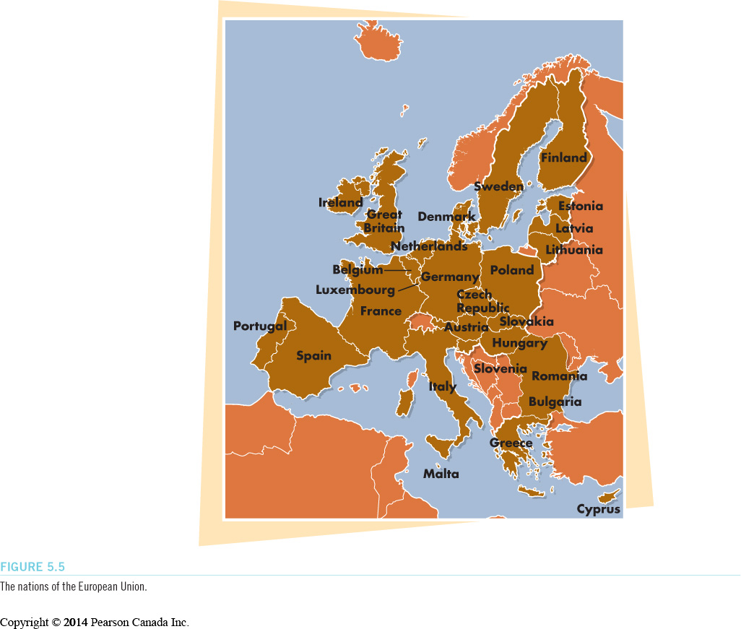
Overcoming Barriers to Trade
(LO 5-6)
European Union (EU)
  Largest free marketplace in the world
  28 countries, plus more waiting to join
  Eliminated most quotas and set uniform tariffs within the union
  https://europa.eu/european-union/about-eu/countries_en#28members
Copyright © 2014 Pearson Canada Inc.
5-<number>
Notes:
27
27
27
Learning Objective: 5-6
Figure 5.5
Activities
The EU is a free trade zone. Canada, the US and Mexico are also a free trade zone. Have students discuss: What countries in Europe are not part of the EU? Why (some library research may be required to facilitate this discussion). Why were some countries opposed to the Euro? Would it benefit Canada, the US and Mexico to have a single currency? What would be the pros and cons of such an approach?

Slide 32
Overcoming Barriers to Trade
(LO 5-6)
North American Free Trade Agreement
https://www.theglobeandmail.com/politics/article-the-road-to-a-new-nafta-a-recap/
https://business.financialpost.com/news/economy/cars-cows-and-a-crisis-averted-highlights-of-a-new-nafta-deal
Came into effect in 1994
Goal to remove tariffs and other trade barriers between Canada, the United States, and Mexico
Copyright © 2014 Pearson Canada Inc.
5-<number>
Notes:
28
28
28
Learning Objective: 5-6
Notes
Canada and the US have negotiated trade issues for over 100 years.

Slide 33
Overcoming Barriers to Trade
(LO 5-6)
Consumers’ Fears of Free Trade
  Job losses
  Market flooded with goods produced in low-wage countries like Mexico
  Loss of control over environmental standards, natural resources, Canadian cultural sovereignty
Copyright © 2014 Pearson Canada Inc.
5-<number>
Notes:
31
31
31
Learning Objective: 5-6
Activity
Invite a local guest speaker from small business, government, and/or environment movement. Ask the speaker to address free trade in the class discussion. Following the discussion students may be asked to research the topic, or write a summary of the key points raised by the speaker, and whether or not they agree or disagree.

Slide 34
Overcoming Barriers to Trade
(LO 5-6)
Consumer Support for Free Trade
  Access to lucrative US markets for Canadian exporters
  Increased jobs due to increased exports
  Environment is not covered or threatened by free trade agreements
  Nothing threatening natural resources, cultural sovereignty
Copyright © 2014 Pearson Canada Inc.
5-<number>
Notes:
30
30
30
Learning Objective: 5-6
Figure 5.6
Activities
Using small groups, have each team discuss the arguments for or against free trade. Using library research, have each team investigate a particular industry to determine the effects of free trade on each market niche.

